Slide 1
CS 3305A
Memory Management
Lecture 15

Slide 2
Agenda
Intro to Memory management
Memory Hierarchy
Memory Allocation Techniques
Contiguous Memory Allocation
Fixed Allocations
Variable or Dynamic Allocation
Address Binding
Logical Address and Physical Address
Mapping from Logical to Physical Address

Slide 3
Introduction
Our machines today have 10,000 times more memory than the IBM 7094 – leading edge machine of the 1960’s
Cost of memory has dropped dramatically
There is a high-performance machine at Western (for bioinformatics research) with 1 terabyte of memory

Slide 4
Introduction
Software and data sets expand to fill the memory available
The 1 terabyte of memory – the researchers already want more
Operating systems must manage memory

Slide 5
Introduction
Memory management requires
Allocate memory to processes when needed
Keep track of what parts of memory are in use
Deallocate memory when processes are done

Slide 6
Introduction
You can think of memory as a large array of bytes
Each byte has its own address
Fetch an instruction from memory
Instruction is decoded
After instruction execution
Results may be stored back in memory
Each of these operations require memory addresses

Slide 7
Memory Hierarchy
Registers
On-chip Cache
Main Memory
Disk
A CPU waiting for data from main memory is not desired
Remedy: Add fast memory between the CPU and main memory called a cache

Slide 8
Memory Allocation Techniques
Contiguous Memory Allocation
Entire process has to be allocated in a memory in a contiguous manner
Paging
Process can be allocated anywhere in the physical memory in a distributed manner

Slide 9
Contiguous Memory Allocation

Slide 10
Contiguous Memory Allocation
We will start out with the most basic method used that allows multiple processes to reside in memory
With contiguous memory allocation each process is contained in a single section of memory that is contiguous
Fixed Partitioning
Variable / Dynamic Partitioning

Slide 11
Fixed Partitioning
Any program/process, no matter how small, occupies an entire partition of the memory partition
Equal-size or unequal sized
partitions
P1
UNUSED
Can not be used by other process
P1
Operating System
8 M
Operating
System
2 M
8 M
4 M
8 M
6 M
8 M
8 M
8 M
8 M
8 M
12 M

Slide 12
Fixed Partitions
Leads to internal fragmentation
Was used by OS/360 on large IBM mainframes for many years
Today no modern OS uses fixed partitions
Fixed Partition Memory Allocation Algorithms:
First Fit
Best Fit
Worst Fit

Slide 13
Fixed Partitioning Placement Algorithm
Operating system must decide which free block to allocate to a process
Best-fit, and First-fit algorithms
Best-fit algorithm
Choose the block that is closest in size to the request
The smallest block is found for a process

Slide 14
Fixed Partitioning Placement Algorithm
First-fit algorithm
Starts scanning memory from the beginning and chooses the first available block that is large enough.

Slide 15
Fixed Partitions First Fit
P1 = 190
P2 = 400
P3 = 150
P4 = 160
Internal Fragmentation (can NOT be used any other process)
200 | 300 | 50 | 70 | 150 | 450
P1
p1 10 | 300 | 50 | 70 | 150 | 450
P2
p1 10 | 300 | 50 | 70 | 150 | p2 50
P3
p1 10 |p3150 | 50 | 70 | 150 | p2 50
P4
Internal Fragmentation = 10 + 50 + 150
Any External Fragmentation ? = 160

Slide 16
Fixed Partitions Best Fit
P1 = 190
P2 = 400
P3 = 150
P4 = 160
Internal Fragmentation (can NOT be used any other process)
200 | 300 | 50 | 70 | 150 | 450
P1
p1 10 | 300 | 50 | 70 | 150 | 450
P2
p1 10 | 300 | 50 | 70 | 150 | p2 50
P3
p1 10 | 300 | 50 | 70 | p3 | p2 50
P4
p1 10 |p4 140 | 50 | 70 | p3 | p2 50
Internal Fragmentation = 10 + 50 + 140
Any External Fragmentation ? = 0

Slide 17
Dynamic Partitioning
Partitions are of variable length and number (could be equal sized as well)
Processes are allocated to the closest possible match
It solves Internal fragmentation but external fragmentation still possible
To recover from external ragmentation, Compaction is required to obtain a large contagious block of memory
Shift processes so that all free memory is in one block
Computationally expensive process

Slide 18
Dynamic Partitioning Placement Algorithm
Operating system must decide which free block to allocate to a process
Best-fit, First-fit, Worst fit algorithms
Best-fit algorithm
Choose the block that is closest in size to the request
The smallest block is found for a process

Slide 19
Dynamic Partitioning Placement Algorithm
First-fit algorithm
Starts scanning memory from the beginning and chooses the first available block that is large enough.

Slide 20
Dynamic Partitions First Fit
P1 = 190
P2 = 10
P3 = 150
P4 = 100
P5 = 500
Can be used by other process/s
200 | 300 | 50 | 70 | 150 | 450
P1
p1 10 | 300 | 50 | 70 | 150 | 450
P2
p1 p2 | 300 | 50 | 70 | 150 | 450
P3
p1 p2 | p3 150 | 50 | 70 | 150 | 450
P4
p1 p2 |p3 p450 | 50 | 70 | 150 | 450
P5
Any External Fragmentation ? = 500

Slide 21
Dynamic Partitions Best Fit
P1 = 190
P2 = 10
P3 = 150
P4 = 100
P5 = 500
Can be used by other process/s
200 | 300 | 50 | 70 | 150 | 450
P1
p1 10 | 300 | 50 | 70 | 150 | 450
P2
p1 p2 | 300 | 50 | 70 | 150 | 450
P3
p1 p2 | 300 | 50 | 70 | p3 | 450
P4
p1 p2 |p4200 | 50 | 70 | p3 | 450
P5
Any External Fragmentation ? = 500

Slide 22
External Fragmentation and Compaction
xxxx | xx 100 | xx | xxx 30 | xxx | xxx 100
P1 = 200
xxxx | xx 100 | xx | xxx 30 | xxx | xxx 100 | 230

Slide 23
Address Binding
Program execution requires that a program be brought into memory from the disk
The process can reside in any part of the physical memory (unknown to programmer)
Compiler allocates logical addresses to the source program/code
The loader will in turn bind the logical addresses to physical addresses

Slide 24
Address Binding
Memory references in the code (virtual or logical) must be translated to actual physical memory addresses
Run-time Mapping from virtual to physical addresses is done by a hardware device called the memory-management unit (MMU)

Slide 25
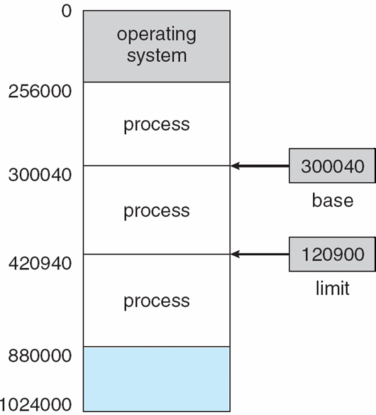
Simple MMU for Address Mapping
The base register holds the physical memory address
The limit register specifies the range
These registers can be loaded only by the operating system
Ensures the user program doesn’t access anything beyond the range

Slide 26
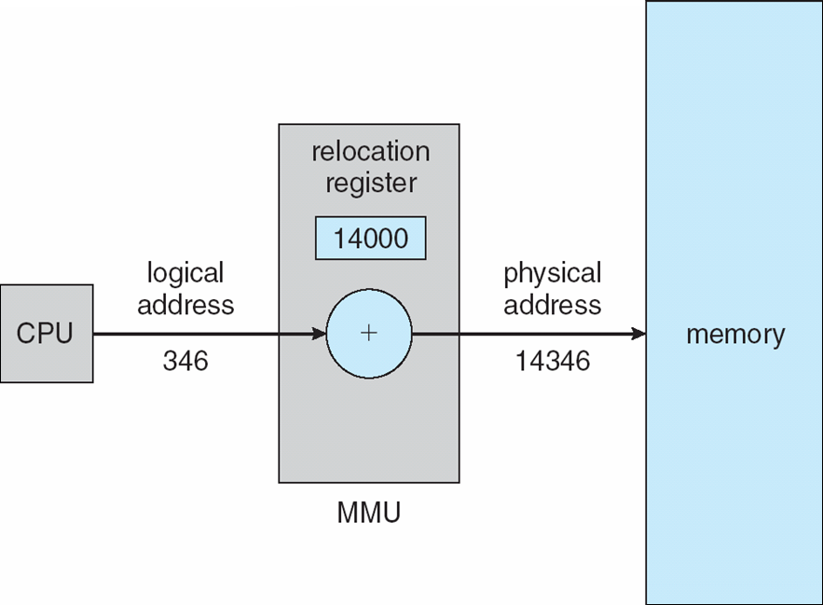
Simple MMU for Address Mapping
Simple mapping from logical addresses to physical
Relocation register: Value is added to every address generated by a user process

Slide 27
Address Binding
CPU
Physical Address
Assigns Logical
Addresses
0
1
2
3 int i
4 int j
5 char a
6 char *s
7 int sum
8 sum = i+j
9
10 int i
11 int j
12 char a
13 char *s
14 int sum
15 sum = i+j
0 int i
1 int j
2 char a
3 char *s
4 int sum
5 sum = i+j
Base Reg: 3
p1
Limit Reg: 8
0 int i
1 int j
2 char a
3 char *s
4 int sum
5 sum = i+j
Base Reg: 10
Limit Reg: 15
p2

Slide 28
Address Binding
CPU wants to access p1 logical address 3
Physical Memory
0
1
2
3 int i
4 int j
5 char a
6 char *s
7 int sum
8 sum = i+j
9
10 int i
11 int j
12 char a
13 char *s
14 int sum
15 sum = i+j
Logical Addresses
0 int i
1 int j
2 char a
3 char *s
4 int sum
5 sum = i+j
Base Reg 3 + Logical address location (offset) = 6 in physical memory
p1
Limit Reg: 8
0 int i
1 int j
2 char a
3 char *s
4 int sum
5 sum = i+j
Base Reg: 10
Limit Reg: 15
p2
Can CPU access p1 logical address 6?

